Slide 1

BLENDED
LEARNING 101
Oleh: Muhammad Azani Hasibuan S.Kom. M.T.I., PMP
CENTER FOR TEACHING & LEARNING EXCELLENCE
TELKOM UNIVERSITY

Slide 2

DUNIA SEDANG BERUBAH

Slide 3
AKSELERATOR PERUBAHAN
AI
Internet
Ubiquitous computing
Artificial Intelligence

Slide 4
MENGUBAH
CARA KITA BERINTRAKSI
Bertansaksi
Bertransportasi
Berkomunikasi
Mengkonsumsi Informasi

Slide 5
ARAH PERUBAHAN
David Wiley, Professor of Instructional Psychology and
Technology at Brigham Young University.
ISOLATED TO CONNECTED
GENERIC TO PERSONAL
CONSUMING TO CREATING
ANALOG TO DIGITAL
OPEN TO CLOSE
THETHERED TO MOBILE

Slide 6
7. Overworked
1. Easily distracted
5. Independent
2. Social Learners
MODERN LEARNER
4. Always on-the-go
3. Crave constant knowledge
Source: https://elearningindustry.com/7-important-characteristics-modern-learners-elearning-professionals-know

Slide 7
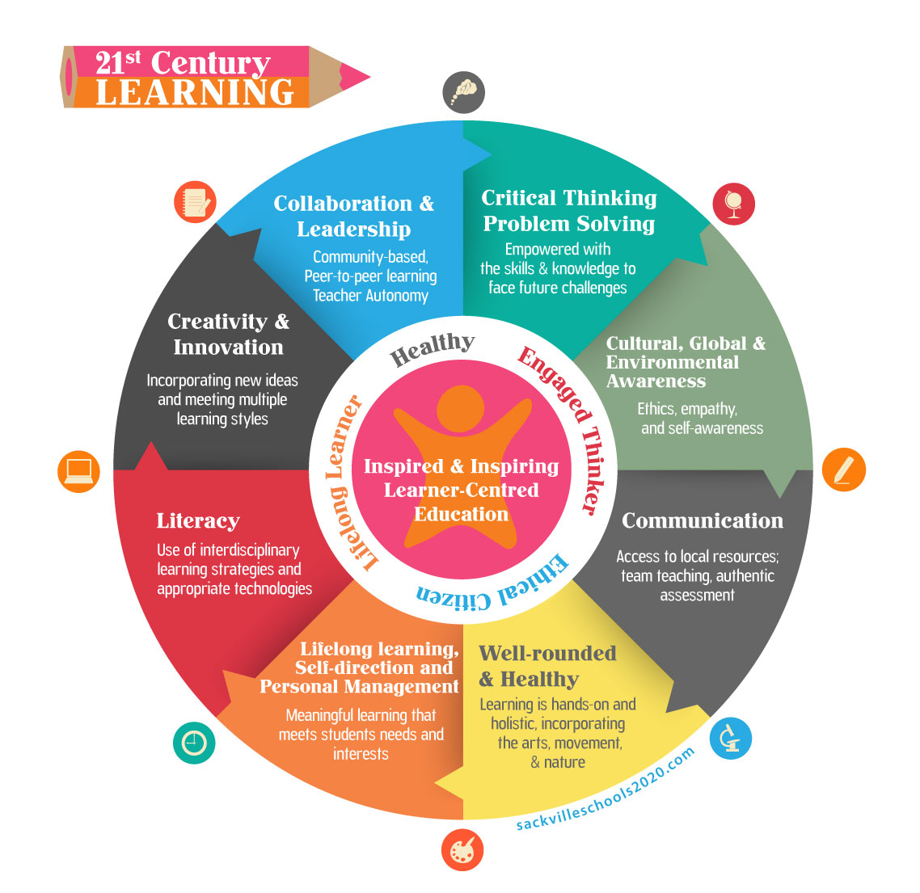
Source: http://www.sackvilleschools2020.com/learning/

Slide 8
We are moving from an era of “universal
schooling” to an era of “lifelong learning,”
(Collins and Halverson 2009)
Notes:
80 percent of our learning happens outside the classroom (Cross 2006).
Most of the learning that happens in people’s lives will not happen in the classroom, but in the workplace and via social connections.

Slide 9
Mastery Based Learning
+
Competency-Based Credentials
+
Alternative and Clearer Paths to Career
Future of Education =
(Sal Khan, founder of khan academy)
https://www.inc.com/quora/salman-khan-these-3-ideas-will-completely-change-how-education-works.html
Notes:
80 percent of our learning happens outside the classroom (Cross 2006).
Most of the learning that happens in people’s lives will not happen in the classroom, but in the workplace and via social connections.

Slide 10
Mastery Based Learning
+
Competency-Based Credentials
+
Alternative and Clearer Paths to Career
Future of Education =
(Sal Khan, founder of khan academy)
https://www.inc.com/quora/salman-khan-these-3-ideas-will-completely-change-how-education-works.html
Notes:
80 percent of our learning happens outside the classroom (Cross 2006).
Most of the learning that happens in people’s lives will not happen in the classroom, but in the workplace and via social connections.

Slide 11
Bagaimana
Pendidikan (tinggi) harus menyesuaikan diri ?

Slide 12

Online Learning
Sebagai Alternatif Solusi

Slide 13
Student Centered Learning
Blended Learning
sebagai Enabler
Personalized Learning
Competency-based learning
Notes:
80 percent of our learning happens outside the classroom (Cross 2006).
Most of the learning that happens in people’s lives will not happen in the classroom, but in the workplace and via social connections.

Slide 14
Blended learning is any formal education program in which a student learns at least in part through online learning, with some element of student control over time, place, path, and/or pace.
(Blended, Using Disruptive Innovation to Improve Schools)
Notes:
80 percent of our learning happens outside the classroom (Cross 2006).
Most of the learning that happens in people’s lives will not happen in the classroom, but in the workplace and via social connections.

Slide 15




MOOC

Slide 16
Why Online
100%
Shifting by online learning
Frequency
0%
100%
Level of Performance

Slide 17
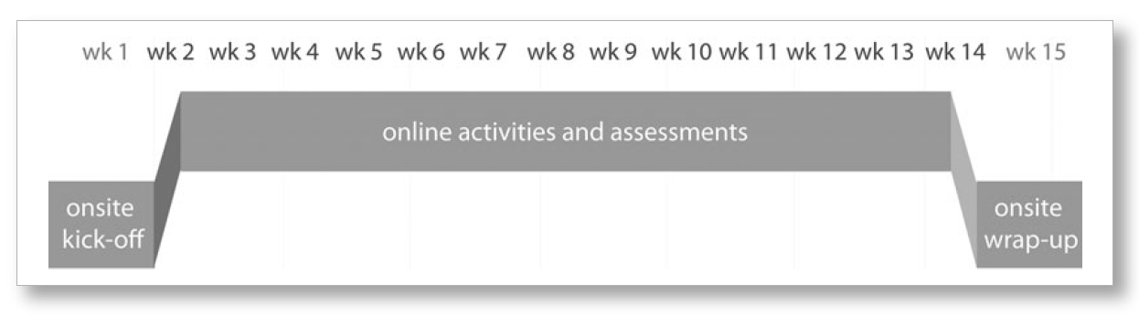
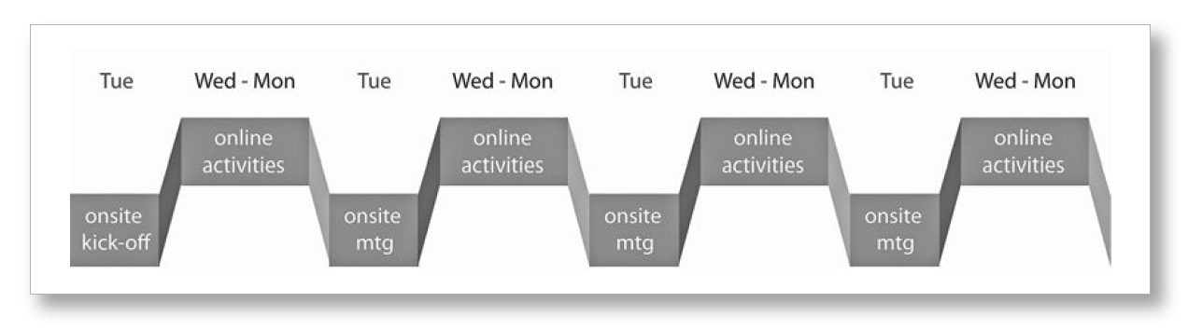
Blended course with on site meeting
Week-to-week Blended Course

Slide 18
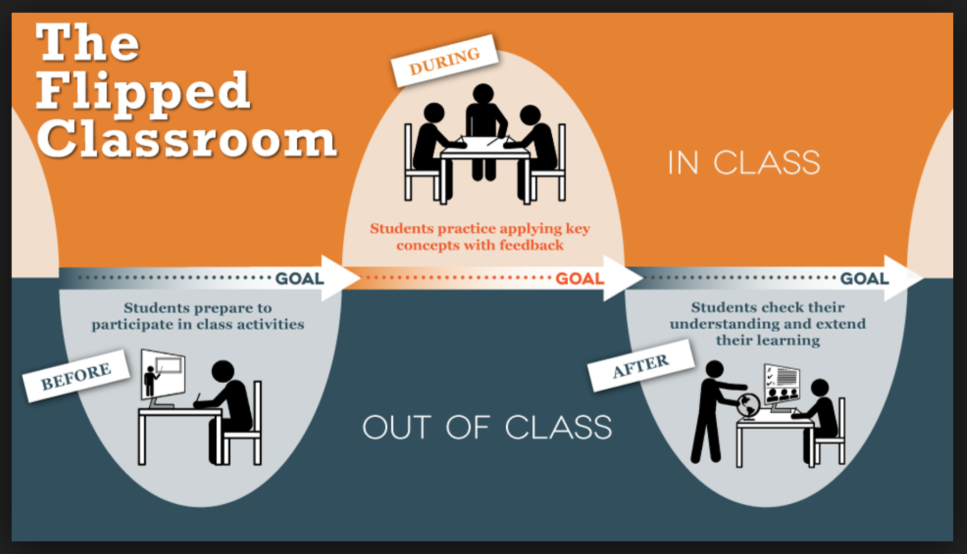
Blended Learning: Flipped Classroom Model

Slide 19

Perancangan Aktivitas Pembelajaran Blended

Slide 20
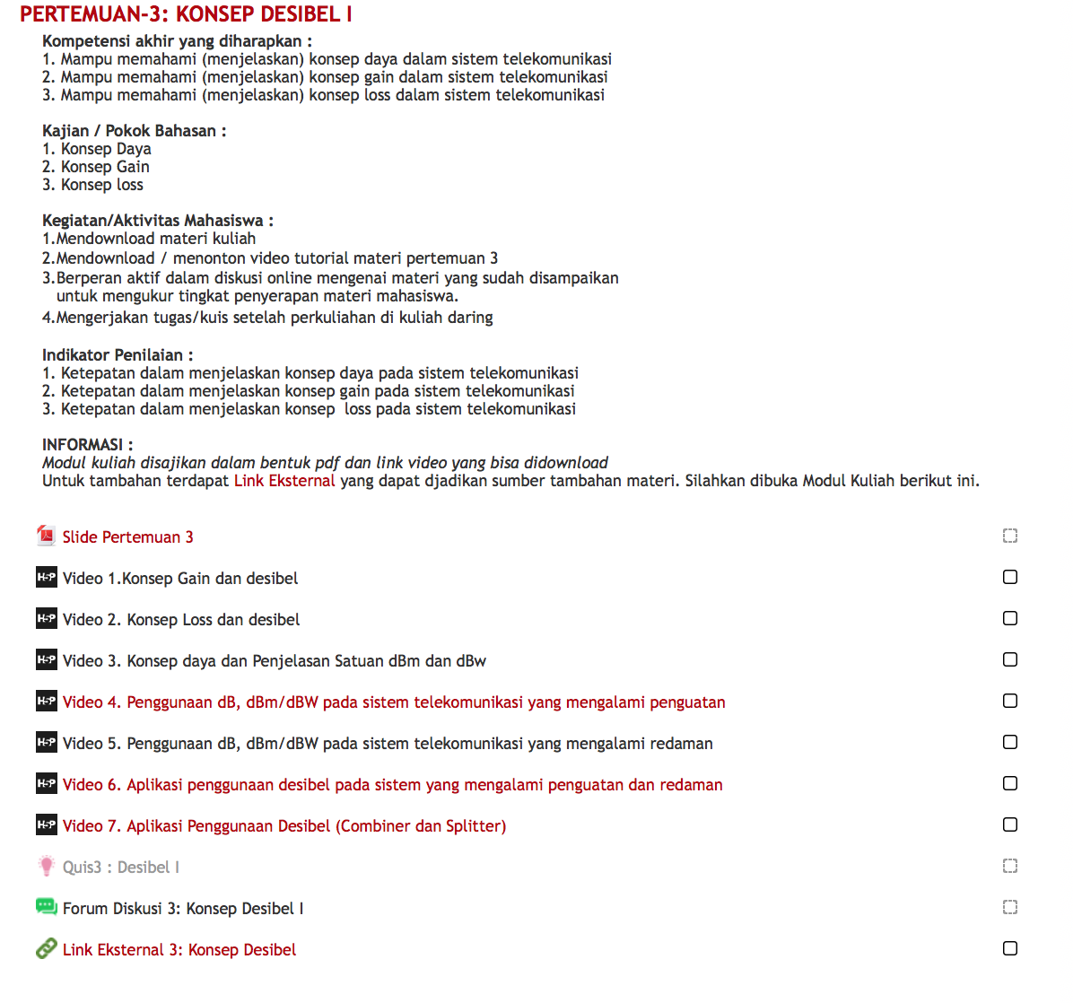
Contoh display konten elearning di Learning Management System

Slide 21








Konten Utama E-Learning Per Pokok Bahasan
1. Panduan Pembelajaran
5. Forum Diskusi
2. Video pembelajaran
6. Quiz Review
3. Lecture Notes
7. Link Sumber Eksternal
4. Pop Quiz (In Video Quiz)
8. Tugas

Slide 22
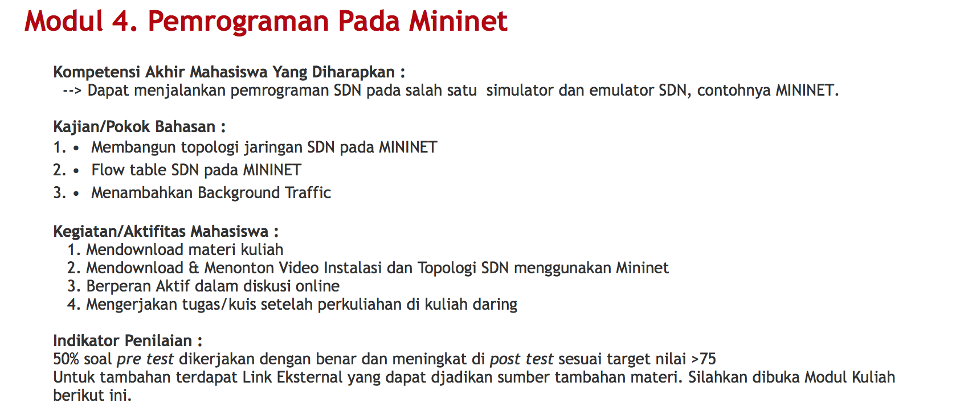
1. Panduan Pembelajaran
Panduan pembelajaran berisi:
  Learning Objective dari pokok bahasan
  Instruksi/panduan dalam mempelajari pokok bahasan
Terdapat di setiap pokok bahasan
Total terdapat 14 panduan pembelajaran
Contoh panduan pemebelajaran pada MK Software Defined Network (S1 TT)

Slide 23
2. Video Pembelajaran
Kriteria dari Video Pembelajaran :
  Durasi per video: 3 – 6 menit
  Jenis konten video: Berupa video talking head, yang dapat dikombinasikan dengan video animasi, screencast, video wawancara, atau video tablet capture (khan style video)
  Resolusi video: minimal 720 p HD (lebar: 1280 pixel dan tinggi: 720 pixel)
  Kualitas audio: High quality tanpa noise
  Terdapat logo Tel-U pada bagian pojok kiri atas
Jumlah
  Minimal 7 video per pokok bahasan
  Total terdapat 98 Video untuk 1 Mata Kuliah

Slide 24
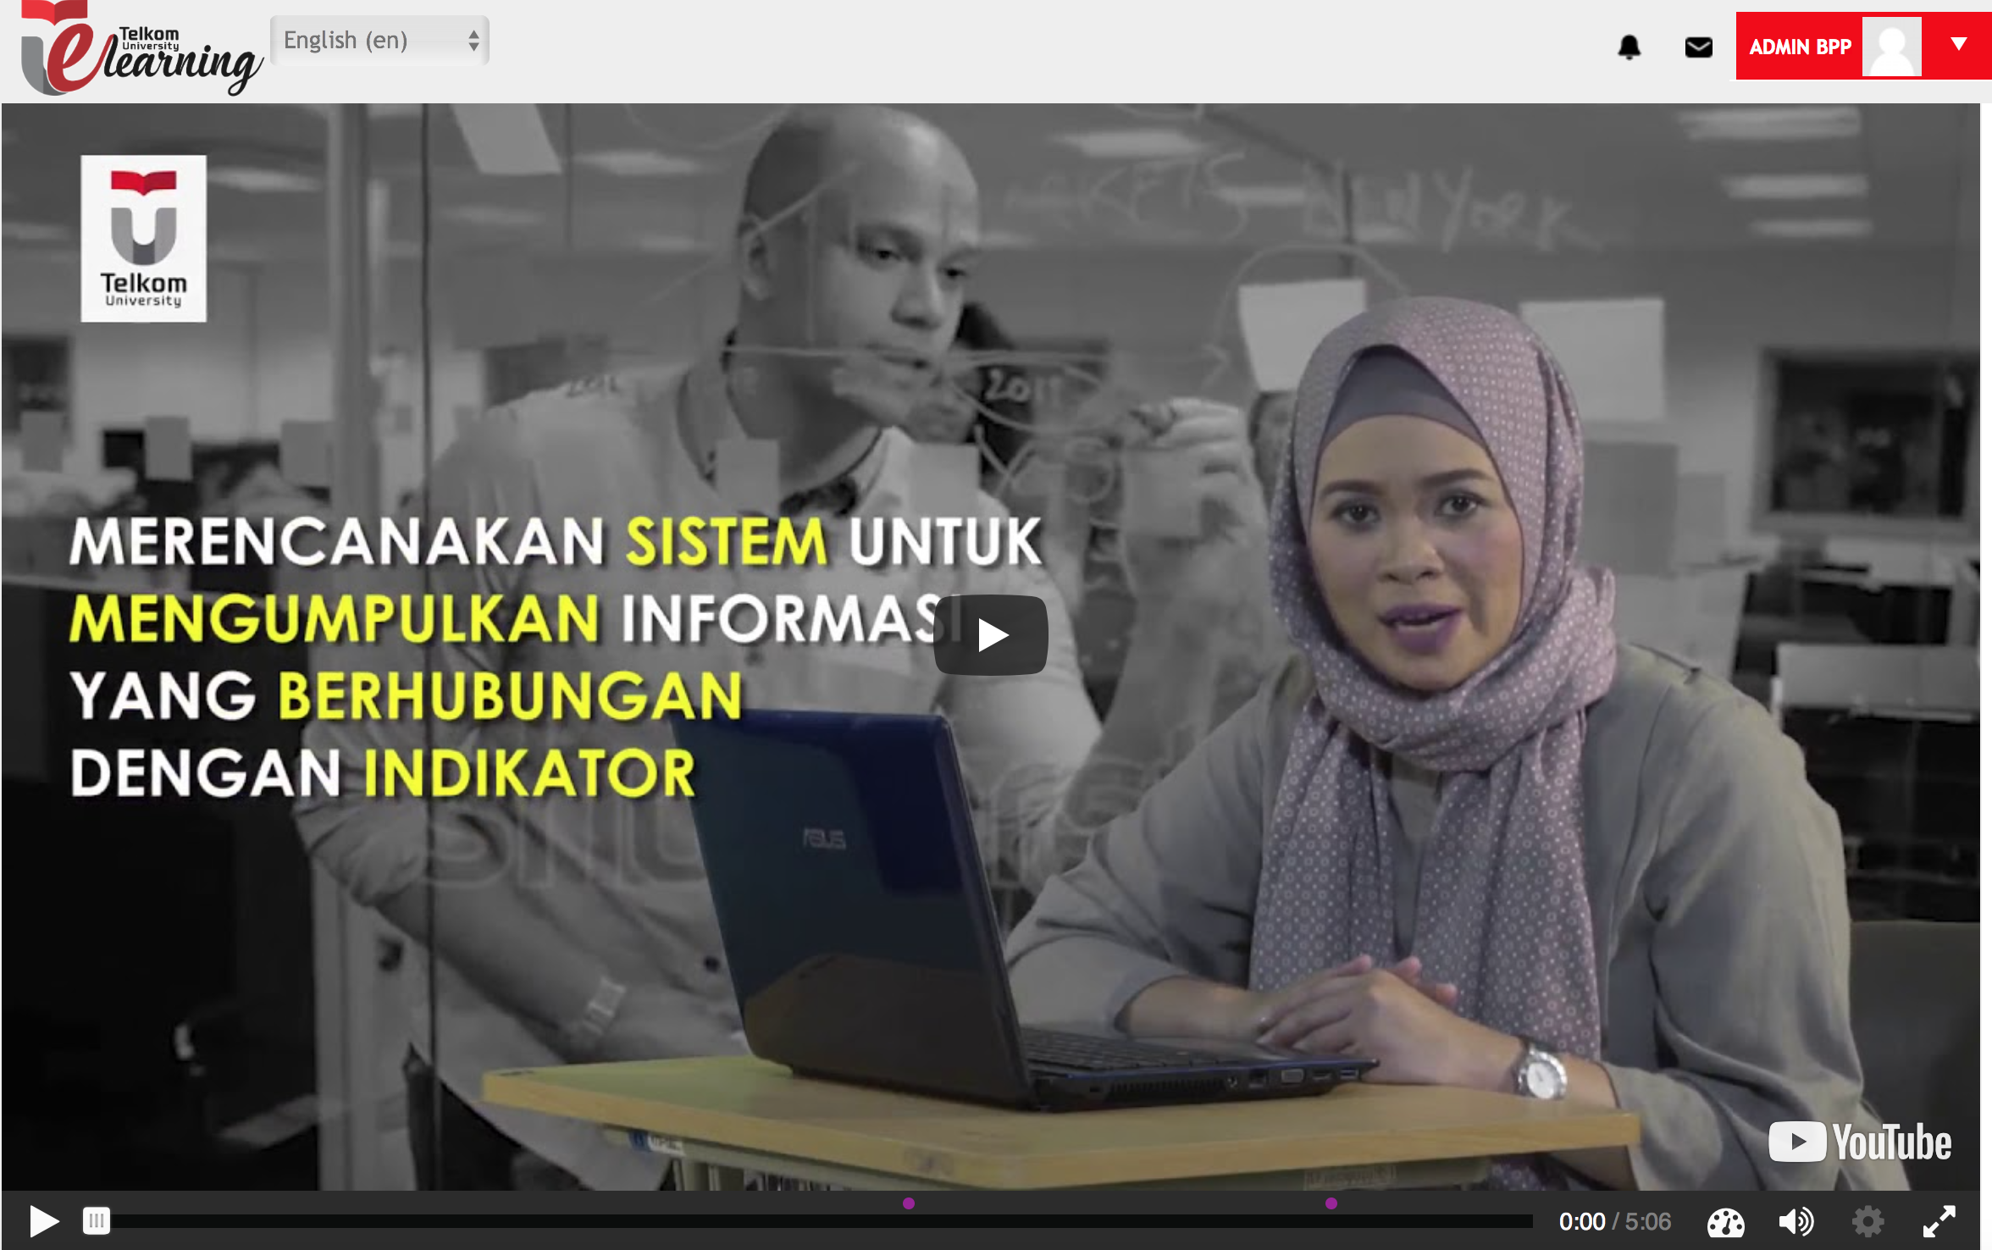
2. Video Pembelajaran (lanj.)
Contoh video pembelajaran
MK Manajemen Acara
Link ke sumber video

Slide 25
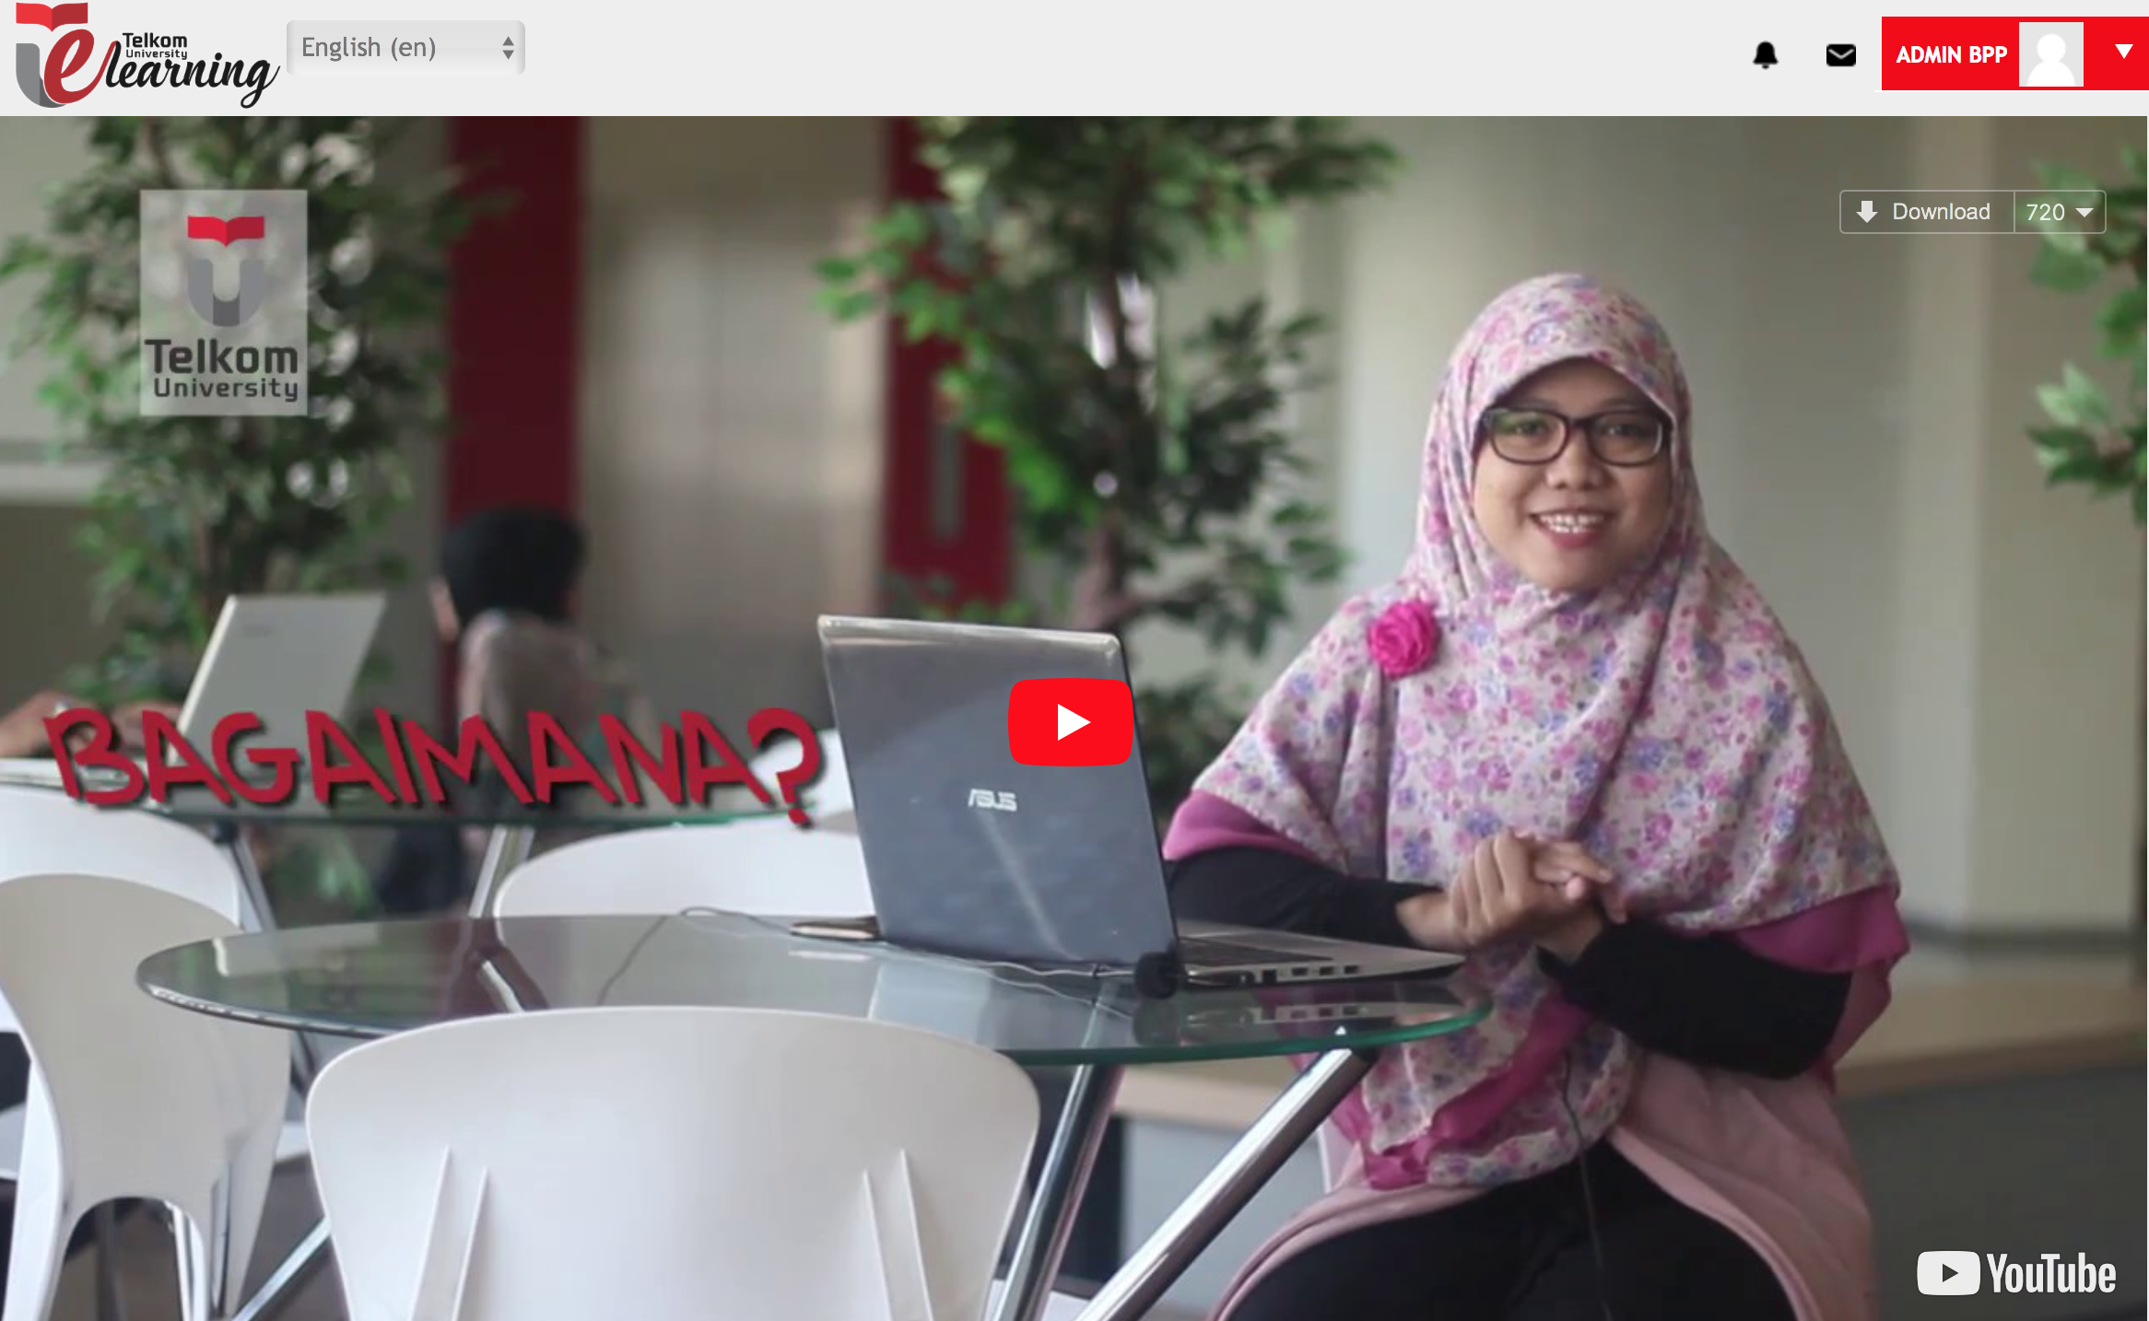
2. Video Pembelajaran (lanj.)
Contoh video pembelajaran
MK Dasar Sistem Telekomunikasi
Link ke sumber video

Slide 26
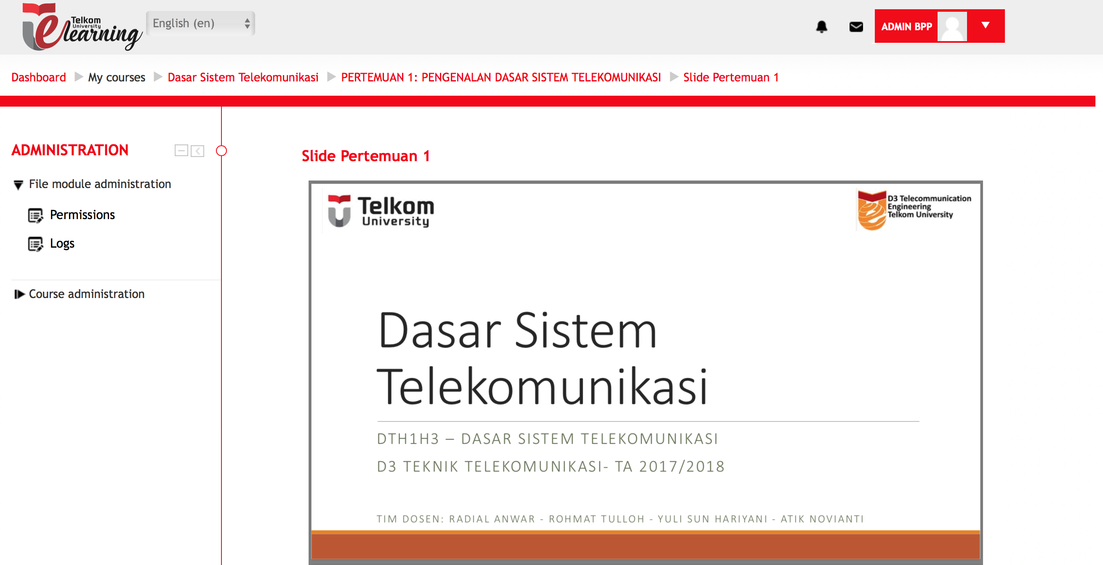
3. Lecture Notes
Lecture note berupa:
slide atau makalah dalam bentuk berkas ppt, ms word atau pdf
minimal 1 berkas per pokok bahasan (total terdapat 14 Lecture Note)
Contoh Lecture Note pada MK Dasar Sistem Telekomunikasi (D3 TT)

Slide 27
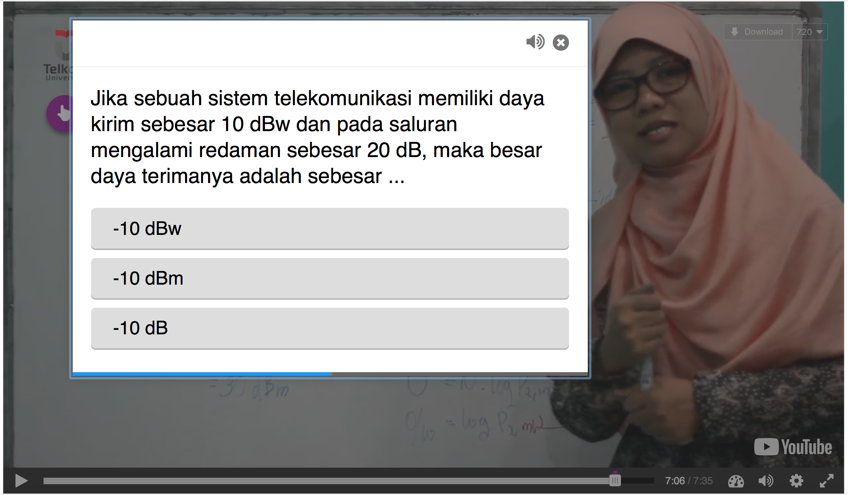
4. Pop Quiz (In Quiz Video)
Pop Quiz berupa:
Quiz yang terdapat di sela-sela video pembelajaran
Minimal 3 soal untuk setiap video
Total terdapat 294 (3x7x14) soal pop quiz per MK
Disertai feedback untuk setiap pertanyaan
Contoh Pop Quiz pada MK Dasar Sistem Telekomunikasi (D3 TT)

Slide 28
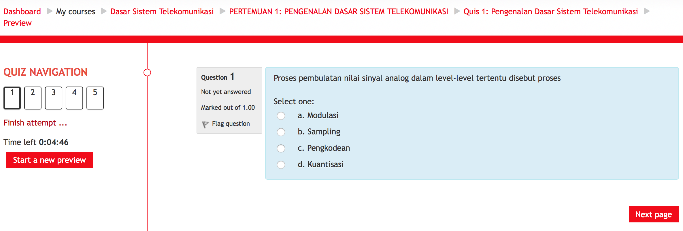
6. Quiz Review
Quiz Review berupa:
pertanyaan pilihan ganda minimal 5 soal beserta dengan bank soalnya (Rasio soal dengan bank soal adalah 1:3) untuk tiap pokok bahasan
Total terdapat 210 (5x3x14) soal review quiz per MK
Contoh Quiz Review pada MK Dasar Sistem Telekomunikasi (D3 TT)

Slide 29
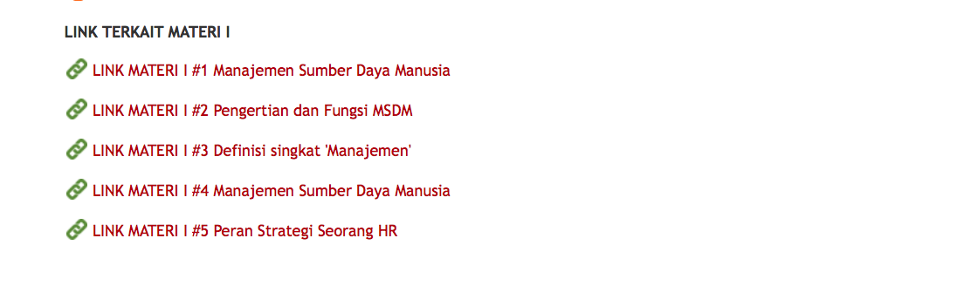
7. Link Sumber Belajar Eksternal
Link Eksternal berupa:
Konten link – link eksternal yang mendukung perkuliahan minimal 1 per pokok bahasan.
Total terdapat 14 link eksternal per MK
Contoh Quiz Review pada MK Manajemen SDM (S1 TI)

Slide 30
Effectivity
Efficiency
Engagement

Slide 31
